Slide 1
Solving two step equations
Solving linear equations

Slide 2
how to use Oak lessons

Slide 3
I can see that when an additive step and a multiplicative step are required to solve an equation, the order of operations will not affect the solution.

Slide 4
An equation is used to show two expressions that are equal to each other.

Slide 5

Solving two step linear equations
Solving using an additive step first
Multiple approaches to solving the same equation

Slide 6


Solving using an additive step first
Solve these one step equations.
2x | = | 10
2x | = | 10
 | =
x | = | 5
x + 4 | = | 10
x + 4 | = | 10
x + 4 + (−4) | = | 10 + (−4)
x | = | 6
What is different about this equation?
2x + 4 | = | 10
It is a two step equation.
There are two operations to ‘undo’.

Slide 7



Solving using an additive step first
Two step equations: Undo both operations.
2x + 4 | = | 10
2x + 4 | = | 10
2x + 4 + (−4) | = | 10 + (−4)
2x | = | 6
2x + 4 | = | 10
2x + 4 + (−4) | = | 10 + (−4)
2x | = | 6
 | =
x | = | 3
After undoing one operation we have isolated the term with the unknown and now have a one step equation to solve.
Check: 2x + 4 = 2(3) + 4 = 10

Slide 8

Solving using an additive step first
We can see both steps undo on our ‘balance’ model:
2x + 4 | = | 10
2x + 4 | = | 10
2x + 4 + (−4) | = | 10 + (−4)
2x | = | 6
2x + 4 | = | 10
2x + 4 + (−4) | = | 10 + (−4)
2x | = | 6
 | =
x | = | 3

Slide 9


Solving using an additive step first
Which first step will isolate the term with the unknown when solving the equation 7x + 10 = 31 ?
7x + 10 | = | 31
7x + 10 + (−10) | = | 31 + (−10)
7x | = | 21
 | =
x | = | 3
+ (−7)
7x + 10 | = | 31
7x + 10 + (−10) | = | 31 + (−10)
7x | = | 21
+ (−10)
+ (−31)

Slide 10
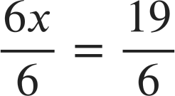
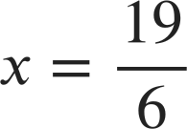
Solving using an additive step first
6x − 13 | = | 6
6x − 13 + 13 | = | 6 + 13
6x | = | 19
6x − 13 | = | 6
Solve
6x + 24 | = | 6
6x + 24 + (−24) | = | 6 + (−24)
6x | = | −18
x | = | −3
6x + 24 | = | 6
6x + 24 | = | 6
6x + 24 + (−24) | = | 6 + (−24)
6x | = | −18
Solve

Slide 11
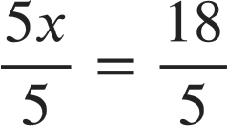
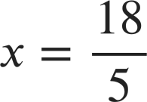
Solving using an additive step first
6x − 13 | = | 6
6x − 13 + 13 | = | 6 + 13
6x | = | 19
6x − 13 | = | 6
5x − 11 | = | 7
5x − 11 + 11 | = | 7 + 11
5x | = | 18
5x − 11 | = | 7
Solve
Solve
6x + 24 | = | 6
6x + 24 + (−24) | = | 6 + (−24)
6x | = | −18
x | = | −3
6x + 24 | = | 6
6x + 24 | = | 6
6x + 24 + (−24) | = | 6 + (−24)
6x | = | −18
5x + 12 | = | 7
5x + 12 + (−12) | = | 7 + (−12)
5x | = | −5
x | = | −1
5x + 12 | = | 7
5x + 12 | = | 7
5x + 12 + (−12) | = | 7 + (−12)
5x | = | −5
Solve
Solve

Slide 12
Solving using an additive step first
1) Manipulate the balance scale to solve the equation 3x − 10 = 2

Slide 13
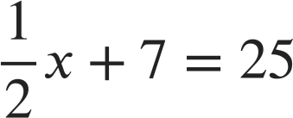
Solving using an additive step first
2) Solve the following equations:
9x + 7 | = | 25
4 | = | 5y + 19
a)
c)
b)
9x − 7 | = | 25
d)

Slide 14
Solving using an additive step first
1) Manipulate the balance scale to solve the equation 3x − 10 = 2
3x − 10 + 10 | = | 2 + 10
3x − 10 + 10 | = | 2 + 10
3x | = | 12

Slide 15
Solving using an additive step first
1) Manipulate the balance scale to solve the equation 3x − 10 = 2
3x − 10 + 10 | = | 2 + 10
3x | = | 12
x | = | 4
3x − 10 + 10 | = | 2 + 10
3x | = | 12

Slide 16
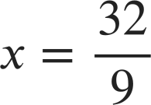
Solving using an additive step first
2) Solve the following equations:
9x + 7 | = | 25
9x + 7 + (−7) | = | 25 + (−7)
9x | = | 18
x | = | 2
9x + 7 | = | 25
9x + 7 + (−7) | = | 25 + (−7)
a)
a)
9x + 7 | = | 25
b)
9x − 7 | = | 25
9x − 7 | = | 25
9x − 7 + 7 | = | 25 + 7
9x | = | 32
9x − 7 | = | 25
9x − 7 + 7 | = | 25 + 7
b)
4 | = | 5y + 19
c)
d)

Slide 17
Solving using an additive step first
2) Solve the following equations:
4 | = | 5y + 19
4 + (−19) | = | 5y + 19 + (−19)
−15 | = | 5y
−3 | = | y
4 | = | 5y + 19
4 + (−19) | = | 5y + 19 + (−19)
c)
a)
9x + 7 | = | 25
b)
9x − 7 | = | 25
We write…
y = −3
4 | = | 5y + 19
c)
d)

Slide 18
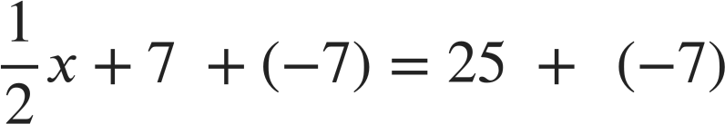
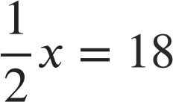
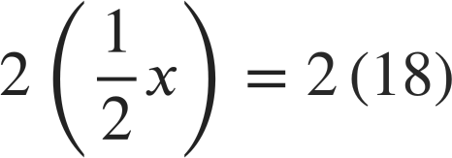

Solving using an additive step first
2) Solve the following equations:
d)
a)
9x + 7 | = | 25
b)
9x − 7 | = | 25
4 | = | 5y + 19
c)
d)

Slide 19
Solving two step linear equations
Solving using an additive step first
Multiple approaches to solving the same equation

Slide 20



Multiple approaches to solving the same equation
Alex is explaining to Izzy how he did this equation we saw earlier.
First I added the additive inverse to isolate the variable term.
2x + 4 | = | 10
2x + 4 + (−4) | = | 10 + (−4)
2x | = | 6
 | =
x | = | 3
2x + 4 | = | 10
2x + 4 | = | 10
2x + 4 + (−4) | = | 10 + (−4)
2x | = | 6
Then I multiplied by the multiplicative inverse to find the value of x
I don’t think we always have to use that order. I think we could do the multiplicative step first!

Slide 21
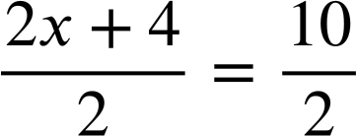
Multiple approaches to solving the same equation
Izzy is now explaining how she solved it.
2x + 4 | = | 10
2x + 4 | = | 10
Do you think Izzy’s idea will work?
Yes, you get the same answer!
That’s awesome Izzy! I think sometimes this might be the most efficient method.
x + 2 | = | 5
x | = | 3
x + 2 | = | 5
Do the multiplicative step first. Like this!

Slide 22
Multiple approaches to solving the same equation
You might see it written in factorised form first.
2x + 4 | = | 10
2x + 4 | = | 10
2x + 4 | = | 10
2(x + 2) | = | 2(5)
x + 2 | = | 5
x | = | 3
2x + 4 | = | 10
2x + 4 | = | 10
2(x + 2) | = | 2(5)
x + 2 | = | 5
x | = | 3
x + 2 | = | 5

Slide 23
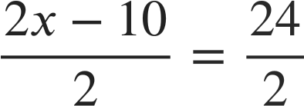
Multiple approaches to solving the same equation
We do the multiplicative inverse first to start solving this equation. What will we write next?
x = 12
2x − 10 | = | 24
x − 10 = 12
x − 5 | = | 12
x | = | 17
x − 5 = 12

Slide 24
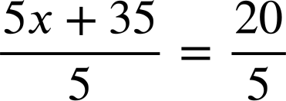
Multiple approaches to solving the same equation
Izzy and Alex are comparing methods
5x + 35 | = | 20
x + 7 | = | 4
x | = | −3
5x + 35 | = | 20
5x + 35 | = | 20
5x + 35 + (−35) | = | 20 + (−35)
5x | = | −15
x | = | −3
5x + 35 | = | 20
5x + 35 | = | 20
5x + 35 + (−35) | = | 20 + (−35)
I’ll do the additive inverse first. Let’s see who is more efficient.
I’ll do the multiplicative inverse first.
Both methods are efficient.

Slide 25
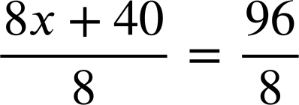
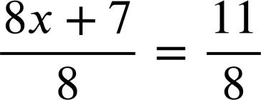
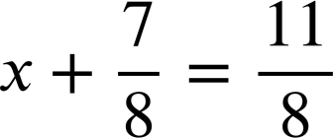
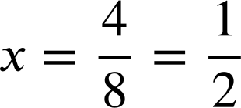
Multiple approaches to solving the same equation
8x + 40 | = | 96
x + 5 | = | 12
x | = | 7
8x + 40 | = | 96
8x + 7 | = | 11
I think I will always do the multiplicative step first.
This can be awkward if not all terms share that factor.

Slide 26
Multiple approaches to solving the same equation
8x + 7 | = | 11
8x | = | 4
8x + 7 | = | 11
8x + 7 | = | 11
More efficient
I think I will always do the multiplicative step first.
This can be awkward if not all terms share that factor.
I should take time to think which method will work best.

Slide 27
Multiple approaches to solving the same equation
For which of the following equations are you most likely to start with the multiplicative step and divide by 3 first?
All three terms have a factor of 3
3 is not a common factor in all terms.
You could divide by 3 but that would introduce fractions.
3x + 21 = 33
3x + 7 = 13
3x + 23 = 31

Slide 28
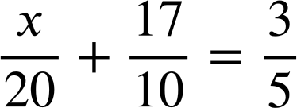
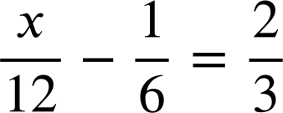
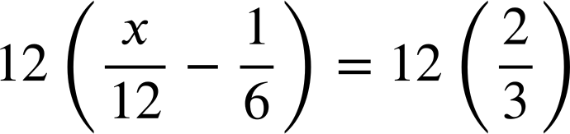
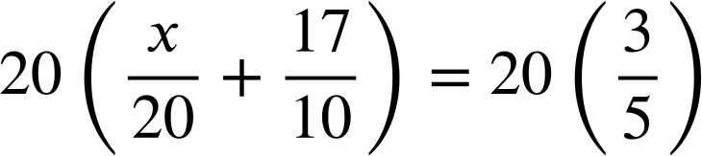
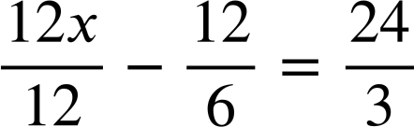
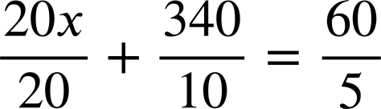





Multiple approaches to solving the same equation
Solve
Solve

Slide 29
Multiple approaches to solving the same equation
1) Solve these equations two different ways.
a) 2x + 18 = 30
b) 3d − 27 = 9
c) 35 − 7x = 21

Slide 30
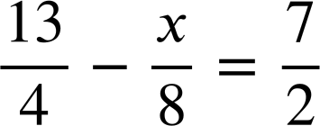
Multiple approaches to solving the same equation
2) Solve:

Slide 31
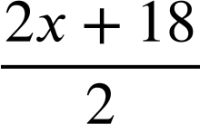

Multiple approaches to solving the same equation
1) Solve these equations two different ways.
Starting with an additive step:
2x + 18 | = | 30
2x + 18 + (−18) | = | 30 + (−18)
2x | = | 12
x | = | 6
a) 2x + 18 = 30
Starting with a multiplicative step:
2x + 18 | = | 30
 | =
x + 9 | = | 15
x | = | 6
2x + 18 | = | 30
2(x + 9) | = | 2(15)
x + 9 | = | 15
x | = | 6
There are many different methods but correct methods will always give the same result.

Slide 32

Multiple approaches to solving the same equation
1) Solve these equations two different ways.
Starting with an additive step:
3d − 27 | = | 9
3d − 27 + 27 | = | 9 + 27
3d | = | 36
d | = | 12
b) 3d − 27 = 9
Starting with a multiplicative step:
3d − 27 | = | 9
(3d − 27) | = | (9)
d − 9 | = | 3
d | = | 12
3d − 27 | = | 9
3(d − 9) | = | 3(3)
d − 9 | = | 3
d | = | 12

Slide 33
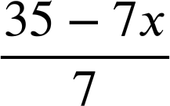

Multiple approaches to solving the same equation
1) Solve these equations two different ways.
Starting with an additive step:
35 − 7x | = | 21
35 − 7x + (−35) | = | 21 + (−35)
−7x | = | −14
x | = | 2
c) 35 − 7x = 21
Starting with a multiplicative step:
35 − 7x | = | 21
 | =
5 − x | = | 3
−x | = | −2
x | = | 2
35 − 7x | = | 21
−7(−5 + x) | = | −7(−3)
−5 + x | = | −3
x | = | 2

Slide 34
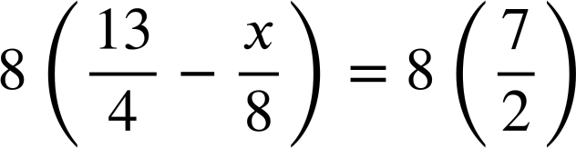


Multiple approaches to solving the same equation
2) Solve:

Slide 35
Solving two step linear equations
We can solve two step equations by undoing the two steps, sometimes by undoing the additive step first, sometimes by undoing the multiplicative step first.
The order of operations does not affect our answer as long as we are accurate in our working.
We have multiple methods to get to the solution, some are more efficient for some equations than others.
You can check your solution is correct by substituting it back into the original equation.

Slide 36

© Oak National Academy 2023.
Produced in partnership with Mathematics in Education and Industry.
Licensed on the Open Government Licence v3.0, except where otherwise stated. See Oak terms and conditions.

